Slide 1
Operating Systems (System Structure)
Presented By Sudeshna Kundu (Mondal)

Slide 2
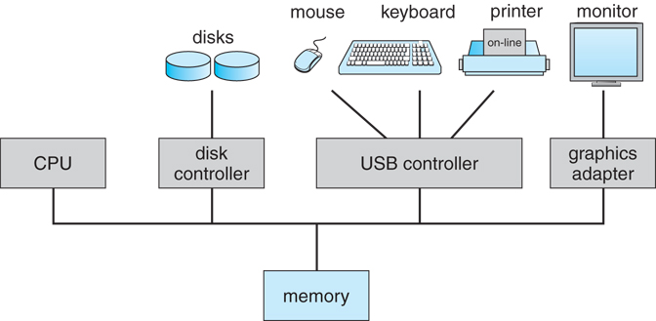
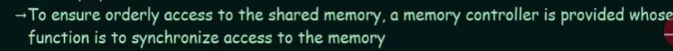
Computer-System Operation
I/O devices and the CPU can execute concurrently
Each device controller is in charge of a particular device type
Each device controller has a local buffer
CPU moves data from/to main memory to/from local buffers
I/O is from the device to local buffer of controller
Device controller informs CPU that it has finished its operation by causing an interrupt

Slide 3
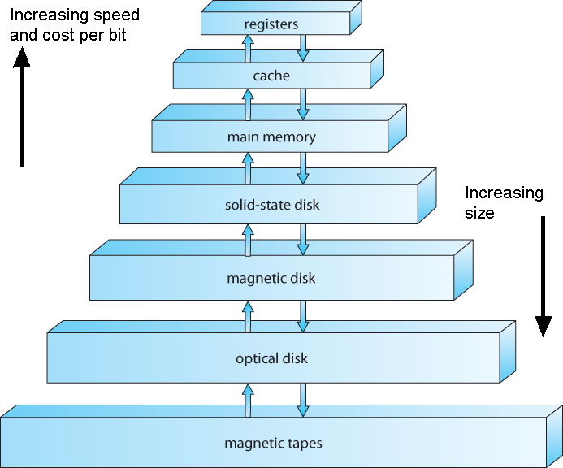
Storage Structure
Main memory ( RAM )
Programs must be loaded into RAM to run.
Instructions and data fetched from RAM into registers.
RAM is volatile
"Medium" size and speed
Other electronic ( volatile ) memory is faster, smaller, and more expensive per bit:
Registers
CPU Cache
Non-volatile memory ( "permanent" storage ) is slower, larger, and less expensive per bit:
Electronic disks
Magnetic disks
Optical disks
Magnetic Tapes

Slide 4
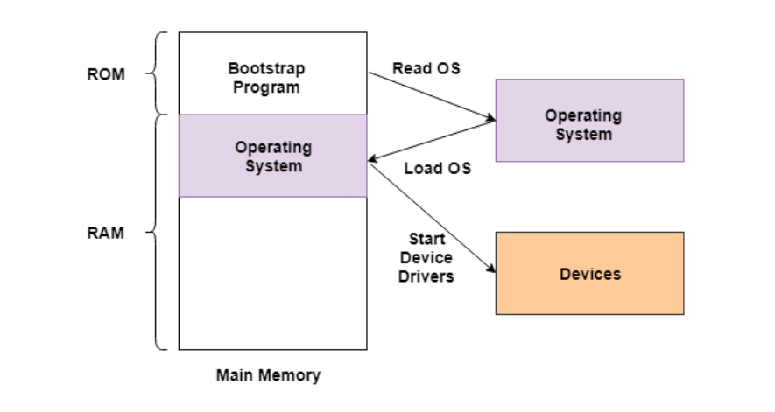
What is a bootstrap program?
A bootstrap program is the first code that is executed when the computer system is started. The entire operating system depends on the bootstrap program to work correctly as it loads the operating system.
In the above image, the bootstrap program is a part of ROM which is the non-volatile memory. The operating system is loaded into the RAM by the bootstrap program after the start of the computer system. Then the operating system starts the device drivers.

Slide 5
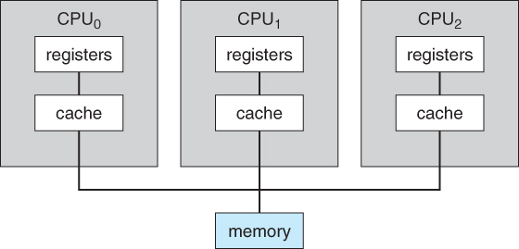
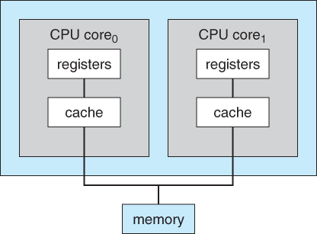
Computer-System Architecture - Different Operating Systems for Different Kinds of Computer Environments
Single-Processor Systems
One main CPU which manages the computer and runs user apps.
Other specialized processors ( disk controllers, GPUs, etc. ) do not run user apps.
Multiprocessor Systems
Increased throughput - Faster execution, but not 100% linear speedup.
Economy of scale - Peripherals, disks, memory, shared among processors.
Increased reliability
Failure of a CPU slows system, doesn't crash it.
Symmetric multiprocessing architecture
A dual-core design with two cores placed on the same chip

Slide 6
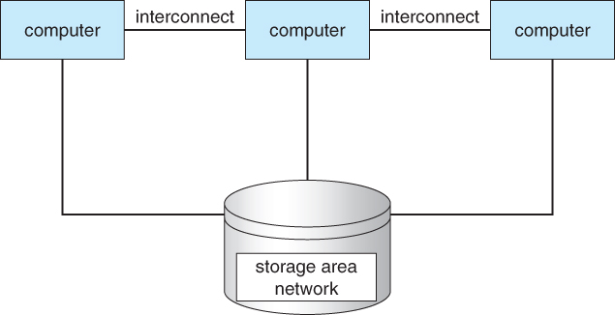
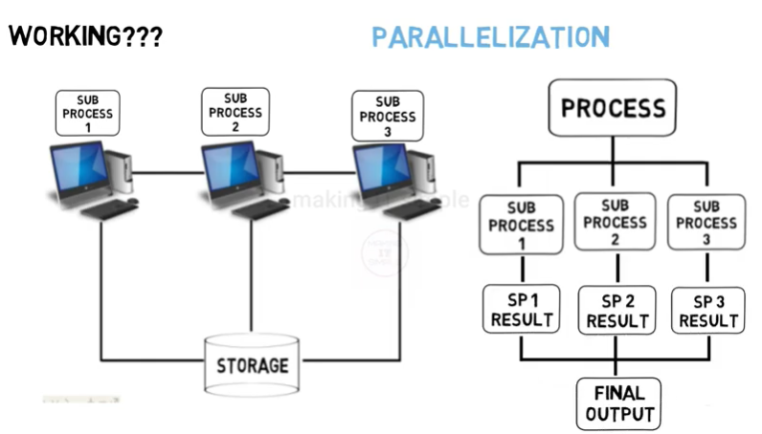
Computer-System Architecture - Different Operating Systems for Different Kinds of Computer Environments
Clustered Systems
Independent systems, with shared common storage and connected by a high-speed LAN, working together.
Special considerations for access to shared storage are required,
General structure of a clustered system

Slide 7
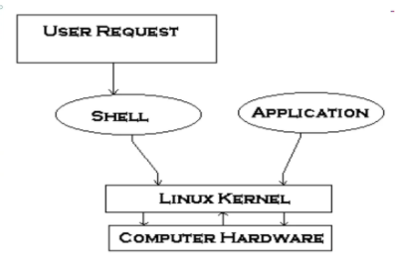
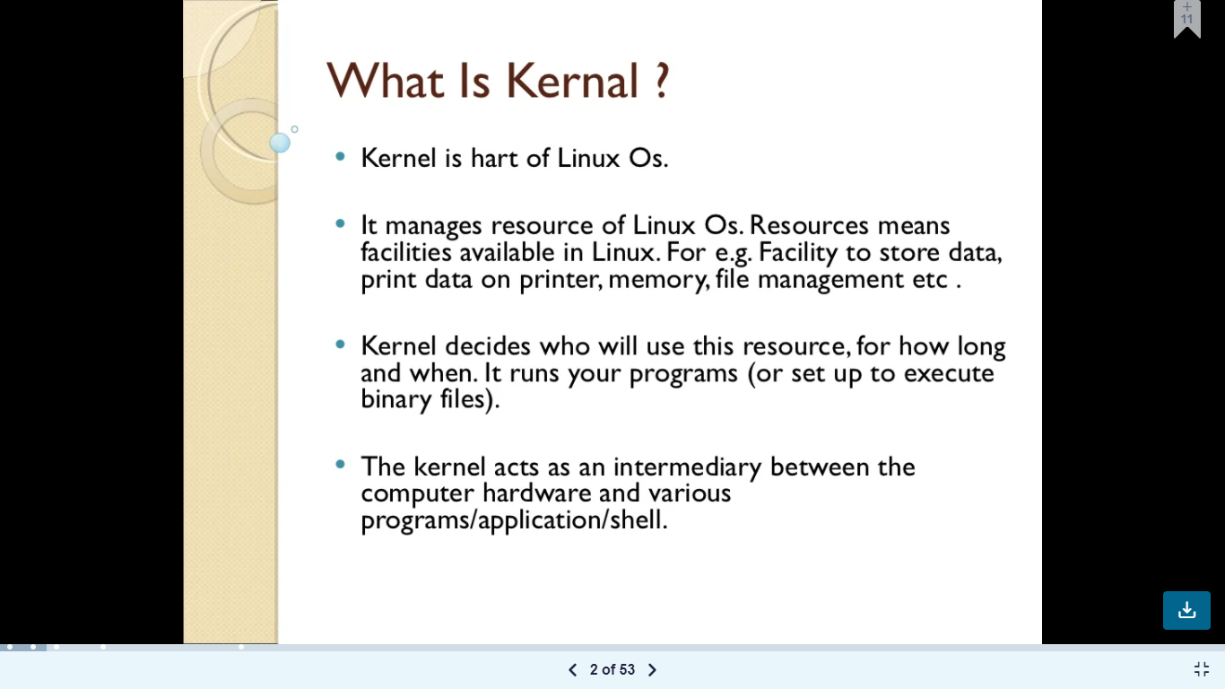
What is Kernel?
Kernel is the core part of an operating system which manages system resources. It also acts like a bridge between application and hardware of the computer. It is one of the first programs loaded on start-up (after the Boot loader).

Slide 8
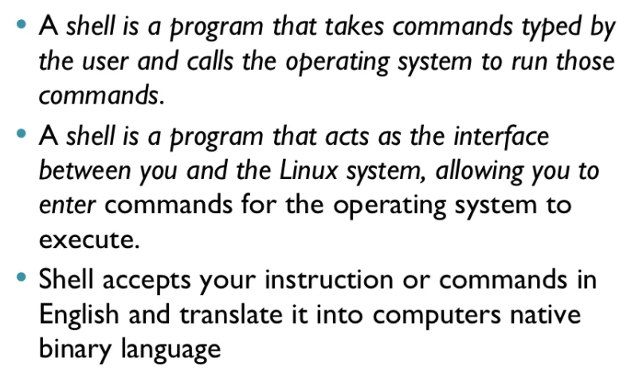
What is Shell?

Slide 9
USER Mode
If CPU is executing the user applications then CPU will be in the user mode. The User applications are games, media players, text editor, MS Office etc.
Executing code in user mode has no ability to directly access some resources like Hard Disk, memory, Printer and other I/O devices. Because, To access these resources we have to use kernel mode through System Call.
Note: User mode is also known as safe mode and Restricted mode.
Kernel Mode
Kernel mode contains OS which has full functionality to access and maintain all the hardware components. Hardware components are RAM, HARD, CPU, printer and other I/O devices.
Whenever the system call generate, CPU switch to kernel mode from user mode. System call is executed in kernel mode. After execution of system call it returns back to user mode.
Note: kernel mode also known as system, privileged (private) or supervisory mode, protected mode because user can’t access this area directly

Slide 10
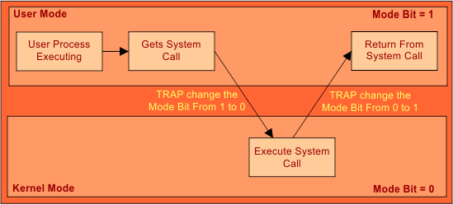
System Call
System call is a way through which we access kernel mode. There are different types of system call to perform different tasks. When System Call is generated then CPU switch form user mode to kernel mode and performs that particular task defined by system call.
Explanation of System Call
As in above diagram, User Applications run in user mode, and operating system run in kernel mode. As OS control all the hardware’s so User cannot access hardware without kernel mode. To access kernel mode user application generate a system call because System call is a source to go to kernel mode.
CPU switch in two modes, while working
User mode
Kernel mode

Slide 11
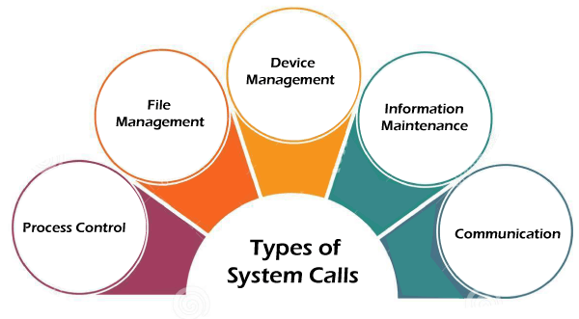
Types of System Calls
Process | Windows | Unix
Process Control | CreateProcess() ExitProcess() WaitForSingleObject() | Fork() Exit() Wait()
File Manipulation | CreateFile() ReadFile() WriteFile() CloseHandle() | Open() Read() Write() Close()
Device Management | SetConsoleMode() ReadConsole() WriteConsole() | Ioctl() Read() Write()
Information Maintenance | GetCurrentProcessID() SetTimer() Sleep() | Getpid() Alarm() Sleep()
Communication | CreatePipe() CreateFileMapping() MapViewOfFile() | Pipe() Shmget() Mmap()
Protection | SetFileSecurity() InitializeSecurityDescriptor() SetSecurityDescriptorgroup() | Chmod() Umask() Chown()
Using MS WORD
To open MS WORD we have to double click on that particular file. As, that file exist in main memory and main memory is a hardware. So, User cannot access the hardware in user mode. User have to request through system call to open the file in main memory. So, OPEN () system call is generated and CPU switch to Kernel mode. Now OS is in kernel mode, it open that particular file from main memory. After opening the file, CPU switch back to user mode. Now we are writing some text in user mode. When user want to save the file then WRITE () system call is again generated. CPU switches to kernel mode to save the file in main memory.

Slide 12
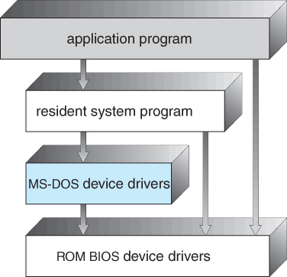
Operating-System Structure
For efficient performance and implementation an OS should be partitioned into separate subsystems, each with carefully defined tasks, inputs, outputs, and performance characteristics. These subsystems can then be arranged in various architectural configurations:
Simple Structure
Such operating systems do not have well defined structure and are small, simple and limited systems. The interfaces and levels of functionality are not well separated.
MS-DOS is an example of such operating system. In MS-DOS application programs are able to access the basic I/O routines.
These types of operating system cause the entire system to crash if one of the user programs fails.
MS-DOS layer structure

Slide 13
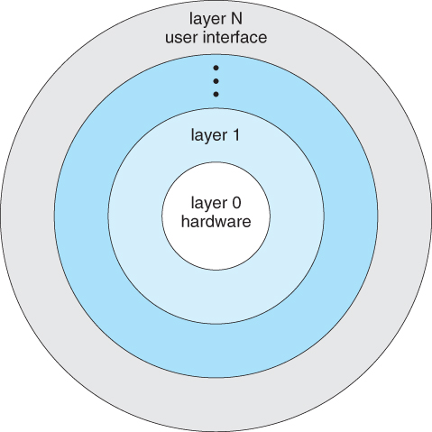
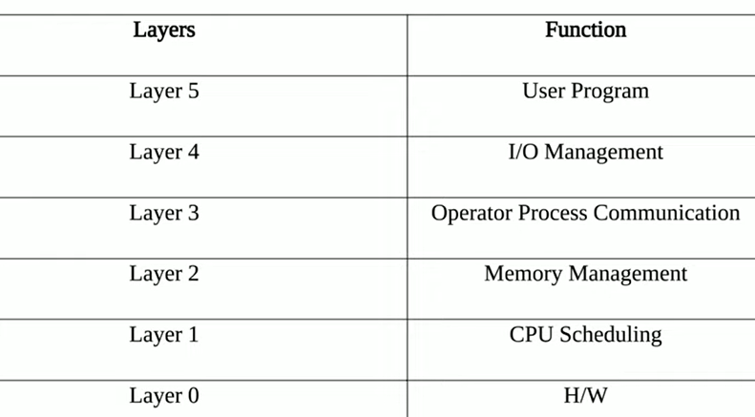
Layered Approach
Another approach is to break the OS into a number of smaller layers, each of which rests on the layer below it, and relies solely on the services provided by the next lower layer.
This approach allows each layer to be developed and debugged independently, with the assumption that all lower layers have already been debugged and are trusted to deliver proper services.
The problem is deciding what order in which to place the layers, as no layer can call upon the services of any higher layer, and so many chicken-and-egg situations may arise.
Layered approaches can also be less efficient, as a request for service from a higher layer has to filter through all lower layers before it reaches the HW, possibly with significant processing at each step.

Slide 14
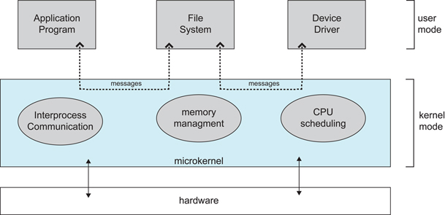
Microkernels
The basic idea behind micro kernels is to remove all non-essential services from the kernel, and implement them as system applications instead, thereby making the kernel as small and efficient as possible.
Most microkernels provide basic process and memory management, and message passing between other services, and not much more.
Security and protection can be enhanced, as most services are performed in user mode, not kernel mode.
System expansion can also be easier, because it only involves adding more system applications, not rebuilding a new kernel.
Mac OS is an example of this type of OS.
Architecture of a typical microkernel

Slide 15
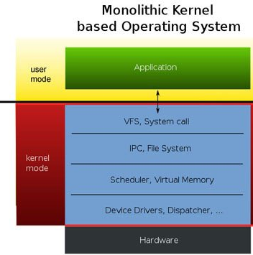
Monolithic Kernel
Monolithic Kernel is another classification of Kernel. Like microkernel, this one also manages system resources between application and hardware, but user services and kernel services are implemented under the same address space. It increases the size of the kernel, thus increases the size of the operating system as well.
Advantages of Monolithic Kernel –
One of the major advantages of having a monolithic kernel is that it provides CPU scheduling, memory management, file management, and other operating system functions through system calls.
The other one is that it is a single large process running entirely in a single address space.
It is a single static binary file. Examples of some Monolithic Kernel-based OSs are Unix, Linux, Open VMS, XTS-400, z/TPF.
Disadvantages of Monolithic Kernel –
One of the major disadvantages of a monolithic kernel is that if anyone service fails it leads to an entire system failure.
If the user has to add any new service. The user needs to modify the entire operating system.

Slide 16
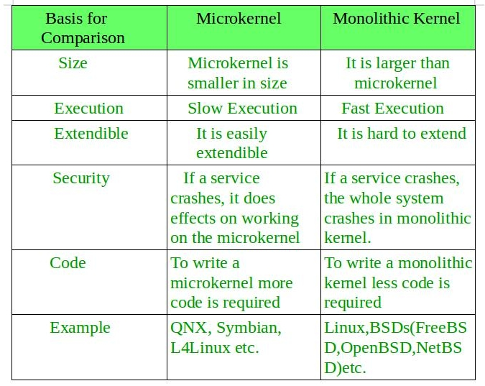
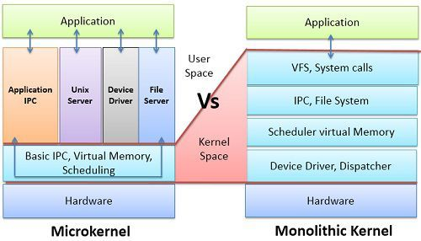
Key differences between Monolithic Kernel and Microkernel –

Slide 17
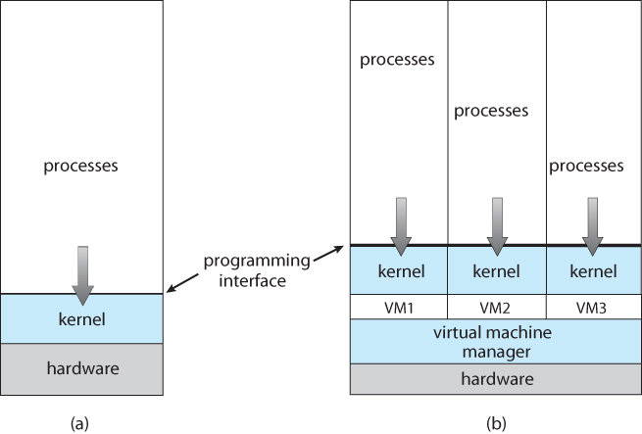
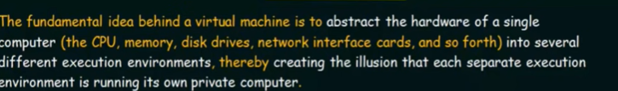
Virtual Machines
The concept of a virtual machine is to provide an interface that looks like independent hardware, to multiple different OSes running simultaneously on the same physical hardware. Each OS believes that it has access to and control over its own CPU, RAM, I/O devices, hard drives, etc.
One obvious use for this system is for the development and testing of software that must run on multiple platforms and/or OSes.
One obvious difficulty involves the sharing of hard drives, which are generally partitioned into separate smaller virtual disks for each operating OS.
System models. (a) Nonvirtual machine. (b)Virtual machine.

Slide 18
History
Virtual machines first appeared as the VM Operating System for IBM mainframes in 1972.
Benefits
Each OS runs independently of all the others, offering protection and security benefits.
Virtual machines are a very useful tool for OS development, as they allow a user full access to and control over a virtual machine, without affecting other users operating the real machine.
As mentioned before, this approach can also be useful for product development and testing of SW that must run on multiple OSes / HW platforms.

Slide 19
Difference between Operating System and Kernel:
Operating System | Kernel
Operating System is a system software. | Kernel is system software which is part of operating system.
Operating System provides interface between user and hardware. | Kernel provides interface between applications and hardware.
It also provides protection and security. | It’s main purpose is memory management, disk management, process management and task management.
All system needs operating system to run. | All operating systems need kernel to run.
Type of operating system includes single and multiuser OS, multiprocessor OS, Realtime OS, Distributed OS. | Type of kernel includes Monolithic and Micro kernel.
It is the first program to load when computer boots up. | It is the first program to load when operating system loads.

Slide 20
THANK YOU

